Slide 1
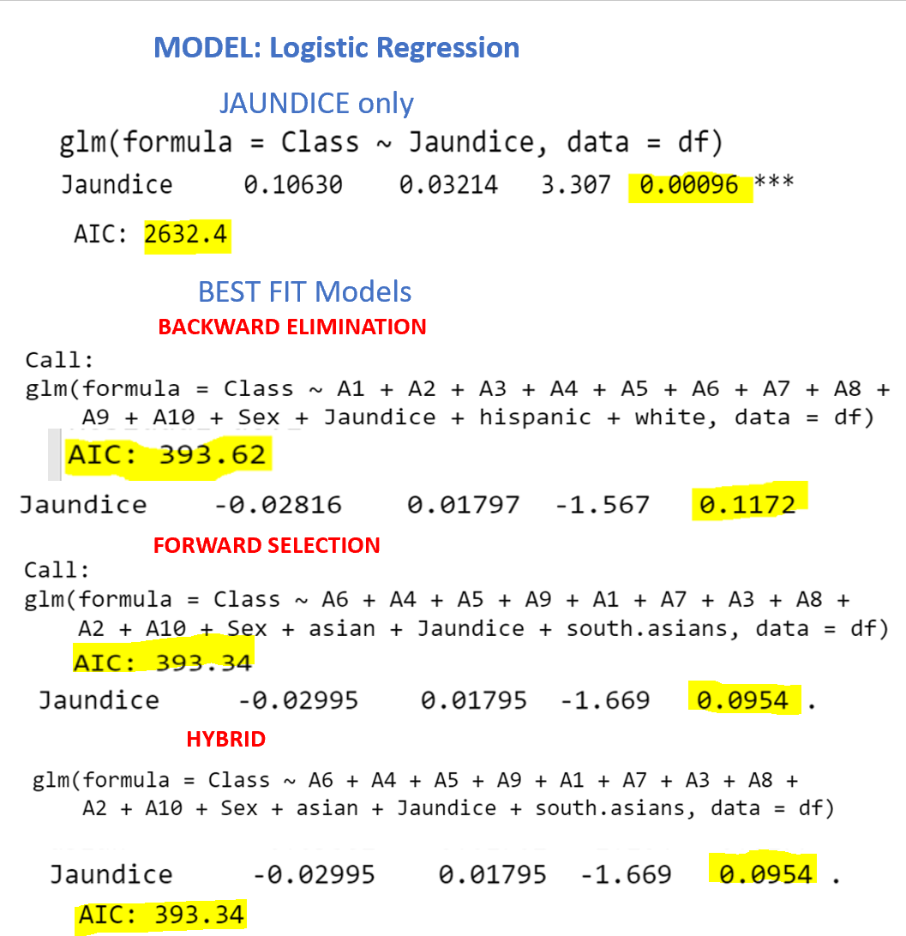

Slide 2
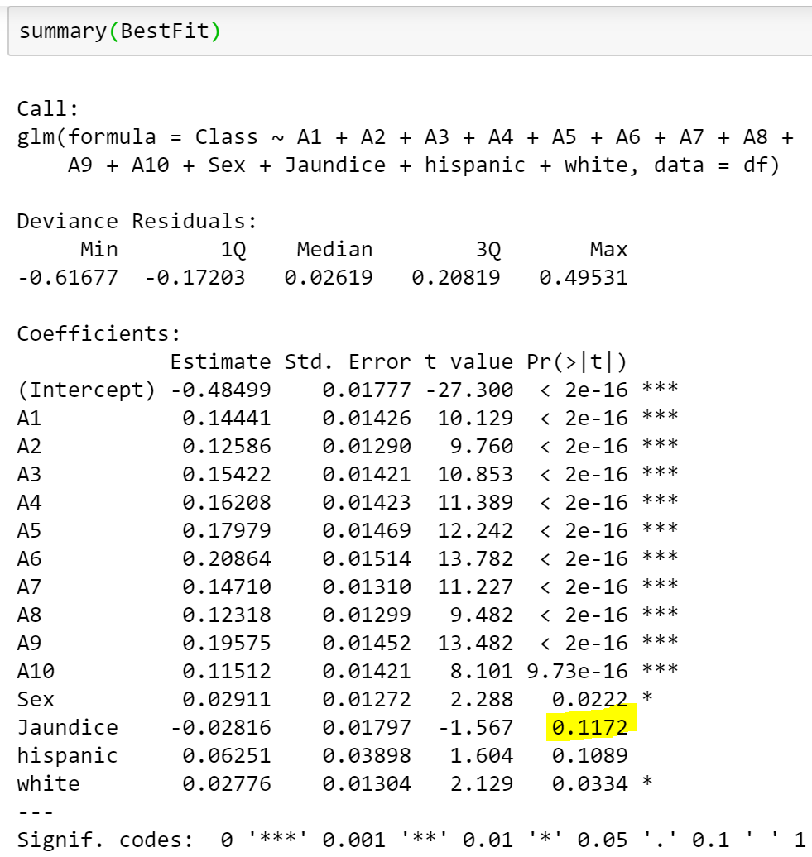
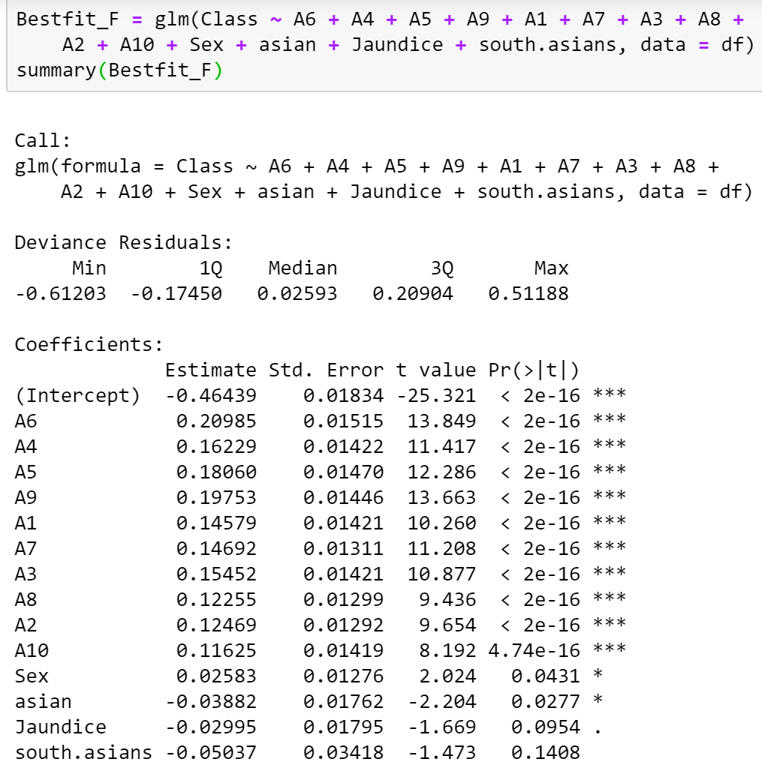
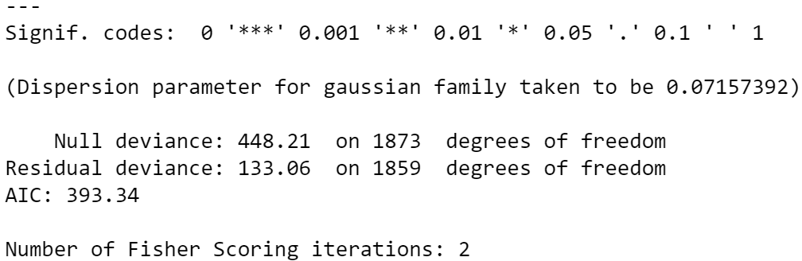
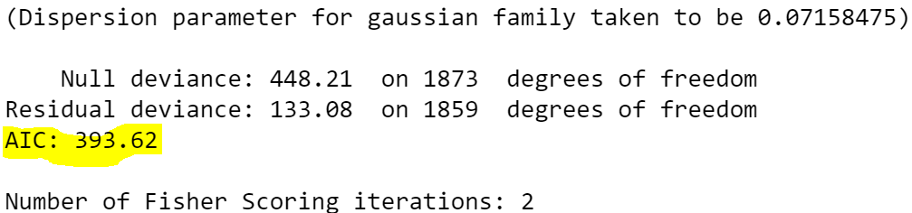
BACKWARD ELIMINATION
FORWARD SELECTION

Slide 3
BACKWARD ELIMINATION
FORWARD SELECTION

Slide 4

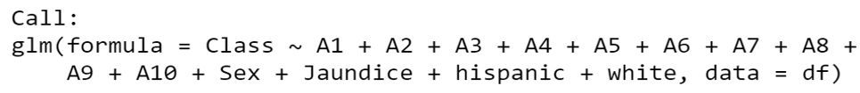


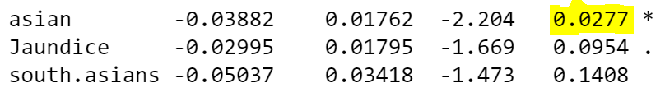

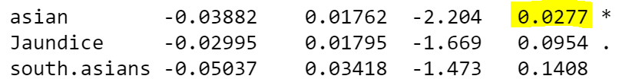
MODEL: Logistic Regression
asian only
BEST FIT Models
BACKWARD ELIMINATION
NO asian or south.asians
FORWARD SELECTION
HYBRID

